Slide 1
Opening Turkish Restaurant in Bucharest
July 2020

Slide 2

Business Problem
Bucharest is the capital and biggest city of Romania, as well as its cultural, industrial, and financial center having 1.883.425(2018) population.
Opening a new Turkish restaurant in Bucharest may be profitable for a restaurant owner. Our problem is Where to open a Turkish restaurant in Bucharest?

Slide 3
Data Sources
I get the sector data of Bucharest from Wikipedia
I get the neighborhood data of Bucharest from Wikipedia
I use python geocoder library to get geographical coordinates of neighborhoods
I use Foursquare API venues explore method to get the venues of given neighborhoods of Bucharest.
I use Foursquare API venues method to get ranks and likes of restaurants by given venue id.

Slide 4
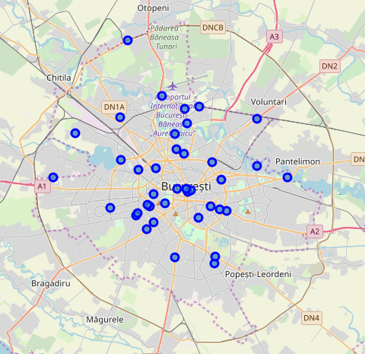
Methodology
I took neighborhood from Wikipedia and put blue dots on Bucharest map to see centers of neighborhoods. There are 40 neighborhoods in Bucharest

Slide 5
Methodology
By using Foursquare API I got venues 1 km around center of each neighborhood with limit 100 venue. I merged data with Neighborhood data.
I filtered All restaurants and Turkish restaurant. We can see from the histogram of restaurants that no neighborhood in Bucharest has a Turkish restaurant

Slide 6
Methodology
I superimposed restaurants with purple markers and restaurants with ratings less than 7 with blue markers

Slide 7
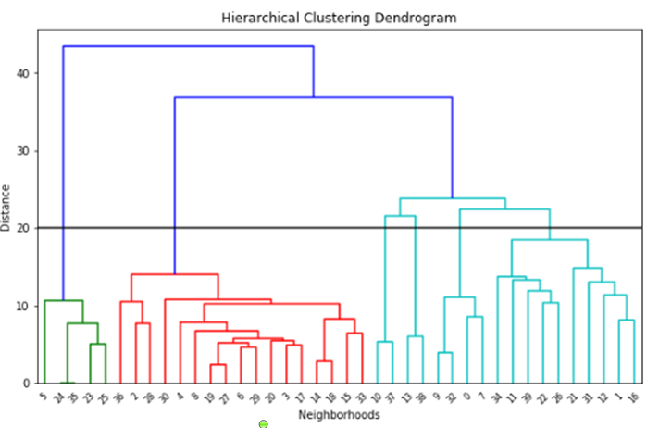
Methodology - Clustering
I used Agglomerative Clustering to cluster neighborhoods according to count of venue categories in each neighborhood. According to the below graph, I decided to separate our neighborhoods into 6 clusters (cut at distance of 20, horizontal black line).

Slide 8
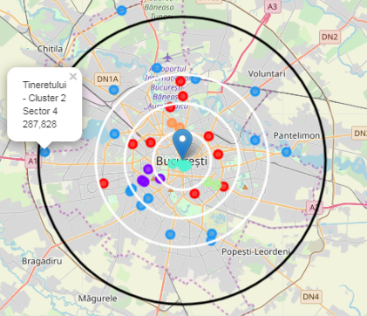
Methodology - Clustering
Agglomerative Clustering gives me 6 clusters:
Cluster 0 ( Red )
Cluster 1 ( Purple)
Cluster 2 (Blue)
Cluster 3 (Cyan)
Cluster 4 (Green)
Cluster 5 (Orange)

Slide 9
Results
Turkish restaurant counts in Bucharest is 0.00%
Total number of restaurants: 20
Total number of Turkish restaurants: 0
From the bar chart, we can see
Vitan is the neighborhood having most restaurants
Dorobanti has lots of restaurants as well
Odai and Gluesti are neighborhoods having least number of restaurants
From the heat maps, we can see that there are
Too many restaurants in 2 km to the center
Enough restaurants between 2-4 km to the center
There are not many restaurants after 4 km to center
From the six clusters, we can see that the top 5 restaurant types are
Coffee shops
Hotels
Dessert shops
Italian restaurants
Pizza places
The predominance of Italian restaurant might be taken to mean that people in Bucharest are open to cuisines from other countries.

Slide 10
Discussions
As there are no Turkish restaurants in all the neighborhoods explored, all neighborhoods are potential options.
However taking into account the other factors outlined in the Results sections such as the predominance of restaurants in certain neighborhoods, the high number of restaurants close to the centre, the below 4 neighborhoods are where I would suggest a Turkish restaurant be opened in Bucharest.
Neighborhood : Regie , Cluster 0, Sector 6 , Population : 367760
I chose Regie , since west part of Bucharest has not Turkish restaurant and Regie is close to center . Regie is red cluster which is same with the other 2 red markers having Turk restaurant. Red clusters populations may like Turkish food.
Neighborhood : Bucureștii Noi , Cluster 2, Sector 1 , Population : 225453
I chose Bucharest-noi , since there is no Turkish restaurant here and because it is after 6 km distance to the centre where there are not too many restaurants. One restaurant will be good for this area.

Slide 11
Discussions
Neighborhood : Crângași , Cluster 2, Sector 6 , Population : 367760
I chose Crangasi , since Crangasi is in the West part of Bucharest and from the bar chart we can see that this neighborhood does not have a lot of restaurants. Also this neighborhood is in Sector 6 and this sector has biggest population which will be ahandle one more restaurant
Neighborhood : Tineretului , Cluster 2, Sector 4 , Population : 287828
I chose Tineretului , since Tineretului has not Turkish restaurant and from bar chart we can see that this neighborhood has not too much restaurant.

Slide 12
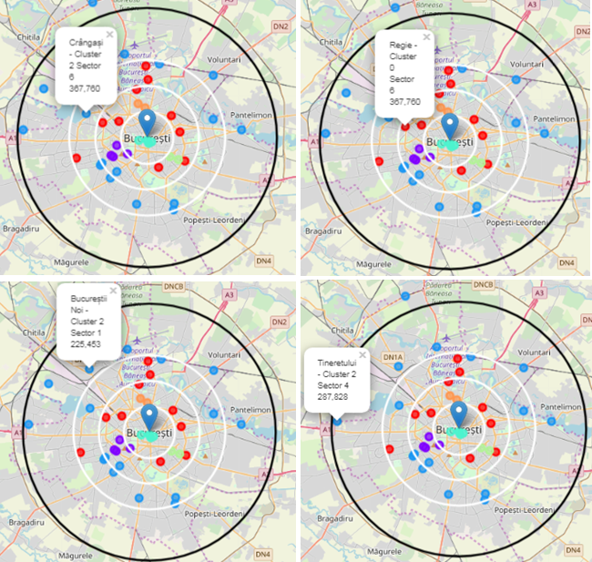
Conclusion
Using the data sources and methodologies outlined earlier, I was able to arrive at 4 possible neighborhoods in Bucharest where a Turkish restaurant can be opened.
Regie
Bucureștii Noi
Crângași
Tineretului

